Slide 1
Beach Boys, Surf Music, and Hot Rods

Slide 2
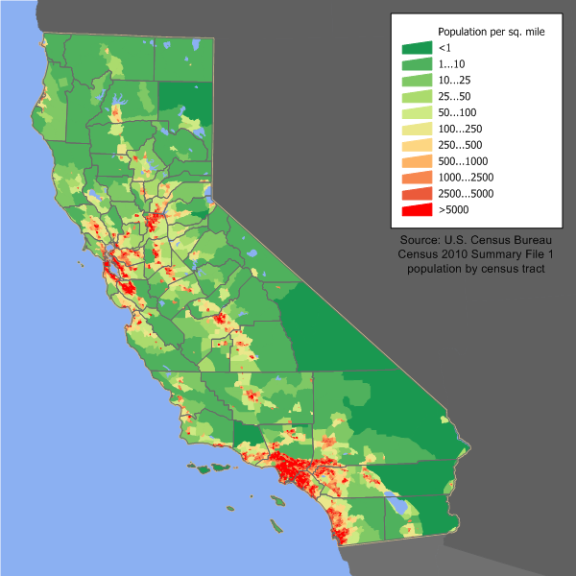

Slide 3
California, another nation?
Huge
Resource rich: gold, oil, minerals, agriculture, tourism
Distant from the eastern seaboard
Beaches
Disneyland, opened July 1955
Silicon Valley: Western Electric, Raytheon, Remington Rand, Zenith, and Motorola
Toy maker Mattel (Hawthorne, CA): Barbie, Disney toys, etc.

Slide 4
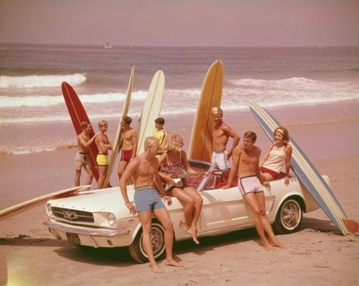
Surf culture, 1950s-1960s
Boards, sticks, woodies, polys
Soup, big guns, harry
Hot dogging,
Bunnies, Barbies
Gremlins, kooks

Slide 5
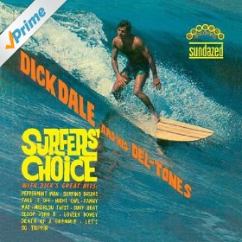
Surf music
Richard Monsour, from Boston to El Segundo, became Dick Dale
Leo Fender: guitars and amps
Michalis Patrinos (from Izmir), “Miserlou,” 1930:
https://www.youtube.com/watch?v=1Qd2Nb-oh4I
Dick Dale and the Del-Tones, “Miserlou,” 1962:
https://www.youtube.com/watch?v=-y3h9p_c5-M
Beach Party (1963):
https://www.youtube.com/watch?v=tm_G_DCJMmY

Slide 6
The Beach Boys, 1961-present
Hawthorne, CA
Brothers Brian, Dennis, and Carl Wilson, their cousin Mike Love, and their friend Al Jardine
First song, “Surfin’”, 1961
Many others followed: most famous was “Surfin USA”:
https://www.youtube.com/watch?v=dbs1luUIxCE
Good Vibrations, 1966:
https://www.youtube.com/watch?v=5IYJtdtr678

Slide 7
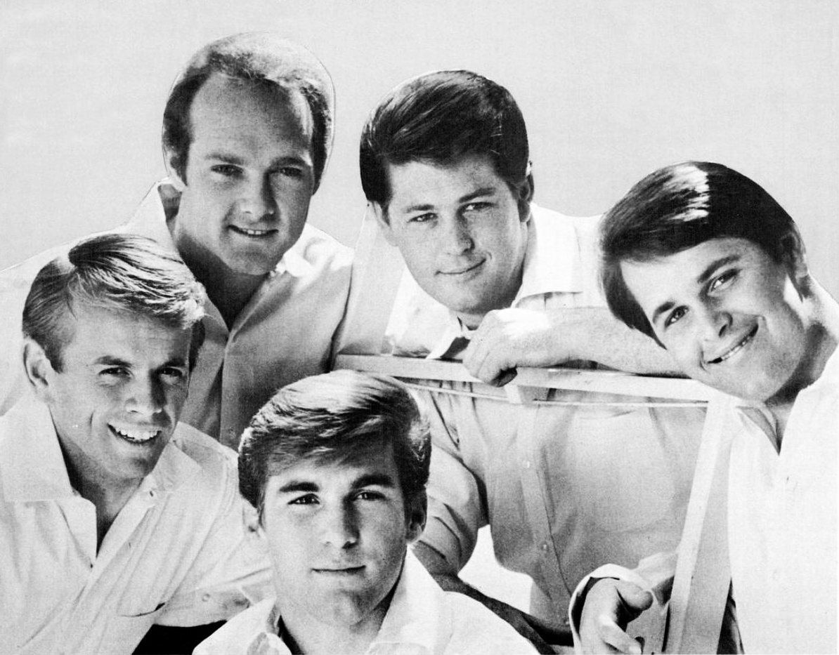
The Beach Boys, 1965

Slide 8
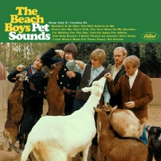
“Pet Sounds”, 1966
Brian Wilson’s project
Worked with lyricist Tony Asher.
Stopped touring.
Focused on recording.
First rock concept album
Initially, not well received in USA, though embraced in the UK.
Single “Wouldn’t it be nice”

